Slide 1
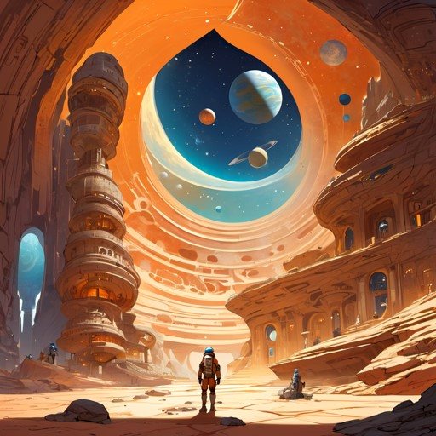

In this span of time, we may ponder, What are we searching for ? What does it mean for humans to seek habitable environments? Does it reflect a fundamental human desire for connection, meaning, and transcendence? WELCOME TO OUR HOME, here comes the unlimited answers!
Your new home is a rock-iron composition like Earth, it orbits at 4.4 million km from its red dwarf star. Our new year takes 6.1 days, and at this distance it only gets 60% of the starlight Earth does. It is roughly the size of Earth with 82% earth gravity surface, it hosts liquid water on its surface. Our captivating Habitat is the fourth planet, out of the seven, in the Trappist-1 planetary system. The trappist-1e.

Slide 2
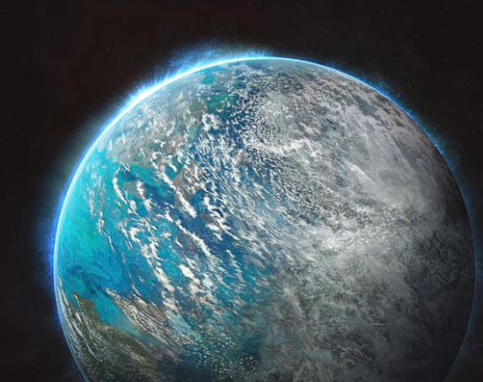
As you set foot on TRAPPIST-1e, you're met with a thriving ecosystem, a testament to our ability to adapt and thrive. Genetically modified oxygen-producing organisms have transformed this once-inhospitable atmosphere. They flourish, using CO2 and sunlight to release oxygen, making the air not just breathable, but teeming with life. It's a harmonious partnership between science and nature, turning TRAPPIST-1e into a lush, oxygen-rich haven for exploration.

Slide 3
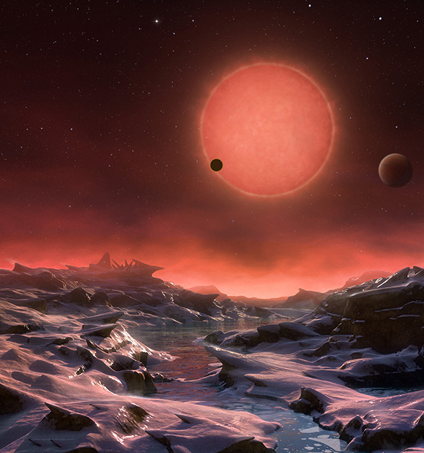
Amidst the vibrant landscapes of TRAPPIST-1e, a profound achievement complements the oxygen-rich atmosphere. Advanced water extraction technology and ingenious water recycling systems have turned this once arid world into an oasis. These innovations harvest water from underground reservoirs and ice caps, ensuring a sustainable and plentiful water supply for the colony. Together with the oxygen-producing organisms, they've transformed TRAPPIST-1e into a thriving, self-sustaining haven for humanity's cosmic ambitions

Slide 4

As you descend onto one of your new habitats, you step onto an untouched landscape, a haven of tranquillity, Moving gracefully through the alien environment, you feel a sense of weightlessness that heightens the extraordinary experience. As we venture into the realm of low gravity exoplanets, our ingenious engineers suggest the use of wearable artificial gravity devices. These devices generate a localized gravitational field around your body to provide the necessary stability and support to experience a level of gravity similar to Earth's.

Slide 5
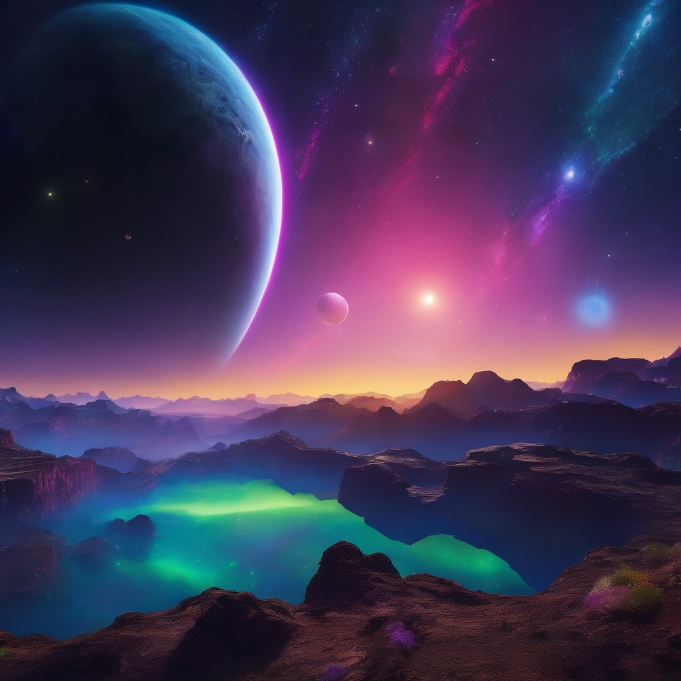
Our new home has exceptionally long day-night cycles due to its orbital characteristics. Advanced lighting systems are utilized to simulate natural day-night cycles and help residents adapt to the planet's unique rhythm. These intelligent lighting systems mimic the spectrum, intensity, and timing of natural light to create an environment that fosters natural biological responses. But you will experience another view, At night, you witness a spectacle beyond imagination as the twin planets align in a breathtaking celestial dance. Their gravitational forces create mesmerizing light displays that illuminate the sky, painting it with brilliant hues of blues, purples, and greens, I can’t imagine how glorious some of the aurora, on our new planet would look like! It's a scene that fills your heart with a sense of wonder and reminds you of the infinite beauty and possibilities of the universe.

Slide 6
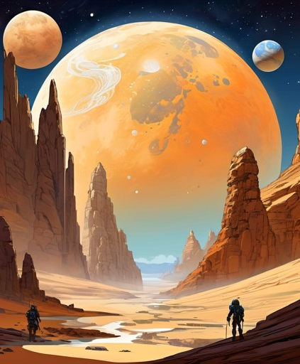
Looking for the ultimate relaxation getaway? Hear out the privilege here. With the Trappist exoplanets located a mere stone's throw away from each other, Imagine hopping between your own "twins" home, experiencing their diverse landscapes and environments, all while enjoying the thrill of space travel.
The close proximity allows for the exchange of resources and knowledge between the planets. The twin planets contain nearly the same ratio of materials as iron, oxygen, magnesium, and silicon. So that Our scientists and explorers could establish research outposts on multiple planets, facilitating collaboration and the advancement of interplanetary science.

Slide 7


Thanks for stopping by, We are waiting
Sarah Manai
Meriam Akaichi
for your next visit, please book here!

